Slide 1
Walmart IoT Workshop

Slide 2
How will this week go?
The process
A guided hack
Try to mimic a real world scenario
Get hands on with tools and technology
Questions
How do you want to work this week?
What goals would you like accomplish this week?
What would we like to accomplish?

Slide 3
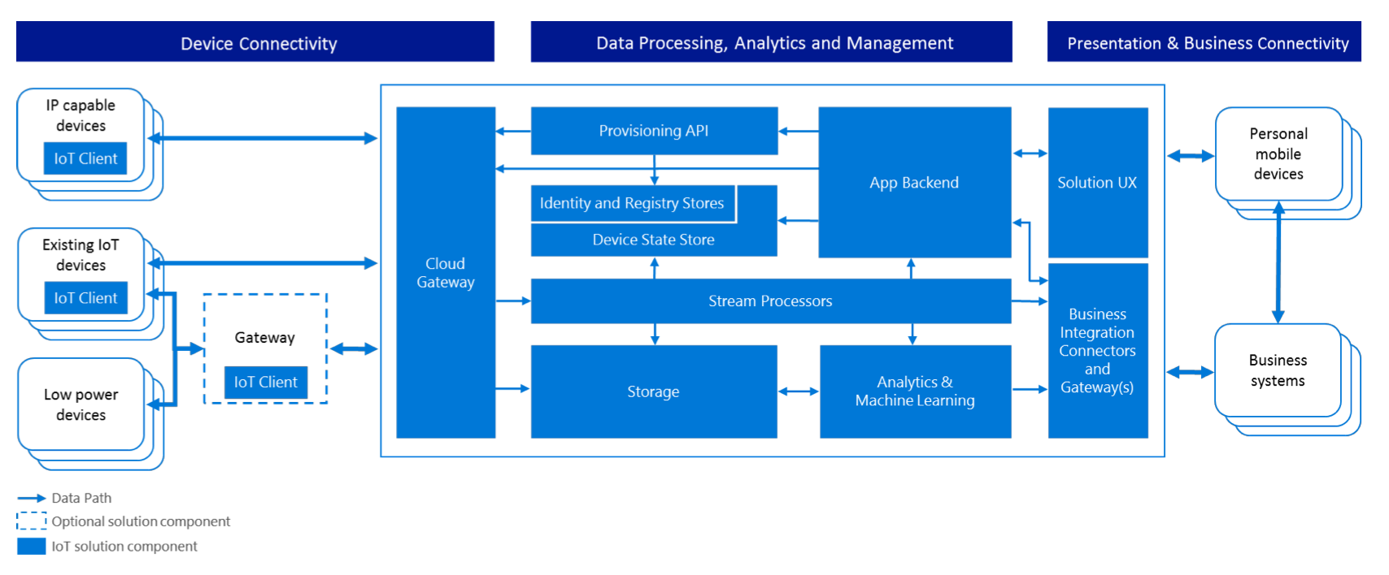
Azure IoT Reference Architecture

Slide 4
Agenda for the week
Day 1
IoT Messaging (cloud)
Ingest, transform, business rules, hot / cold storage
Day 2
Stream Analytics – 1hr
Cosmos DB - 2 hr
IoT Edge v2 – 3 hr
Day 3
ARM template (DevOps) – 1.5 hour
Bot Framework & LUIS - 1.5 hours
Web app (portal, admin, reporting)
Day 4
PowerBI
ML
Day 5
Power Apps
Mobile
Overflow

Slide 5
Day 1 & 2
Set up an IoT Hub in Azure Subscription (US East) (using existing resource group – iottraining)
Copy hub connection string from it
Create console app to simulate device sending messages to cloud
Test message getting from device to cloud- Amend console app to receive message from cloud
Test messages getting from cloud to device
Route messages to storage
(Advanced) hook stream analytics to incoming messages

